Slide 1
Emerging Technologies for the Circular Economy
Lecture 10: Ethereum and Smart Contracts
Part 2
Prof. Dr. Benjamin Leiding (Clausthal)
M.Sc. Arne Bochem (Göttingen)
M.Sc. Anant Sujatanagarjuna (Clausthal)
Notes:
<number>

Slide 2
License
This work is licensed under a Creative Commons Attribution-ShareAlike 4.0 International License. To view a copy of this license, please refer to https://creativecommons.org/licenses/by-sa/4.0/ .
Updated versions of these slides will be available in our Github repository.

Slide 3
News/Updates

Slide 4
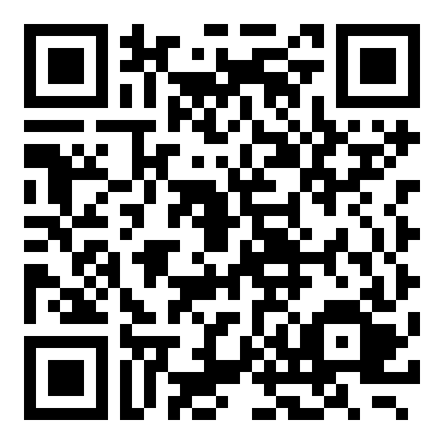
Course Evaluation – QR Code and Link
Link: Click Me

Slide 5
Invited Lectures
06.07.2022 → Invited Lecture (Dr. Ulrich Gallersdörfer)
13.07.2022 → Invited Lecture (Prof. Dr. Steffen Herbold)

Slide 6
Disclaimer and Further Resources
The lecture slides (Figures are often copied directly) are based on the course Blockchain-based Systems Engineering from TU Munich, which is distributed under a CC-BY-SA 4.0 license
All their slides, exercises and further information are available online: https://github.com/sebischair/bbse

Slide 7
Ethereum Decentralized Applications

Slide 8
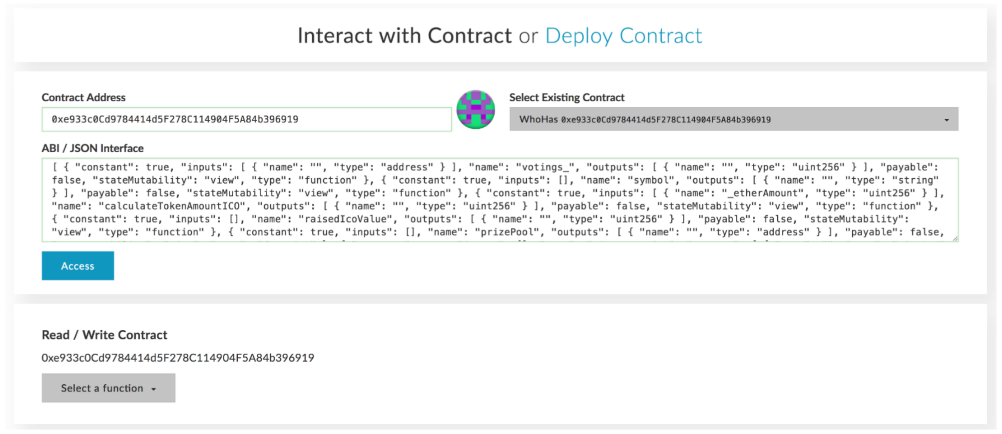
Motivation
Direct interaction with smart contracts is complicated
Smart contracts do not provide a graphical user interface on their own
Programming knowledge or special tools are required to make function calls
U. Gallersdörfer, P. Holl, and F. Matthes, “Blockchain-based Systems Engineering – Lecture Slides,” Oct 2019. [Online]. Available: https://github.com/sebischair/bbse

Slide 9
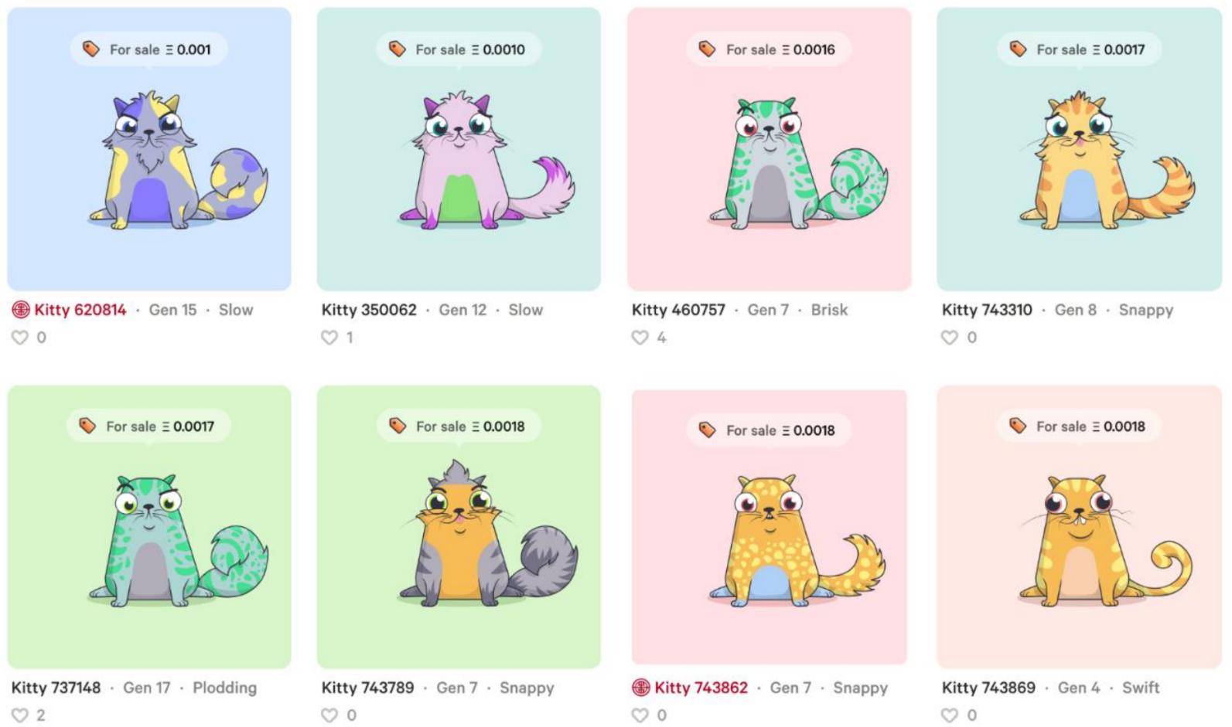
Motivation
Building UIs on top of smart contracts to make them accessible to average users
The UI abstracts the complicated function calls and allows a user to interact with them just like with a regular (web) application
U. Gallersdörfer, P. Holl, and F. Matthes, “Blockchain-based Systems Engineering – Lecture Slides,” Oct 2019. [Online]. Available: https://github.com/sebischair/bbse

Slide 10
Definition
In the community, multiple definitions for dApps exist
In general, a dApp is not necessarily based on a Blockchain, e.g., BitTorrent is a decentralized P2P application without any blockchain involved
In this lecture, we consider a dApp as a decentralized application (in the terms of blockchain) based on one or more smart contracts and accessible via a dedicated user interface
In particular, the following properties must hold:
The core data records of the application must be stored on the blockchain
The functions that change the core data records must be executed on the blockchain, i.e. via a smart contract

Slide 11
Benefits
The meaningfulness of implementing a distributed application is dependent on the concrete use case and / or the problem that is being solved.
Some general properties of Ethereum-based dApps:
Trust
The source code of any verified smart contract can be checked by anyone.
Payment
Payment is implemented by default since anyone can send / receive Ether.
Accounts
dApps can be build on top of Ethereum’s account system, so there is no need to implement an additional user account management system.
Storage
dApps can leverage the Blockchain as common (expensive) data storage.

Slide 12
Drawbacks
Decentralized applications have also some intrinsic disadvantages:
Costs
Any state change and computation costs money. For that reason, only mission-critical data and functionality should leverage the blockchain.
Time
The current block time of Ethereum is around 14 seconds, i.e., it takes at least 14 seconds from the function call to the definite result of it.
Availability
In theory, availability is one of the key advantages of dApps. However, in high transaction scenarios (e.g. the release of crypto kitties) it is possible that the network throttles and is not able to process function calls anymore.
Transparency
Without third party services, it is impossible to access and verify a Smart Contract source code.

Slide 13
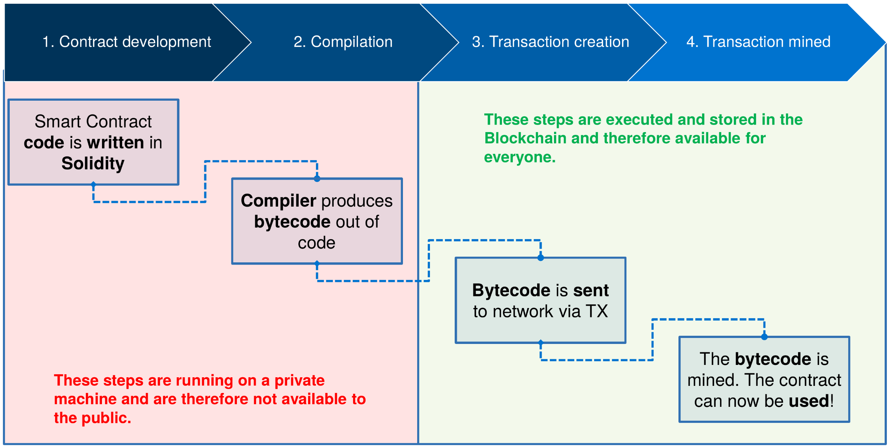
Recap – Deploy Smart Contract on Chain
U. Gallersdörfer, P. Holl, and F. Matthes, “Blockchain-based Systems Engineering – Lecture Slides,” Oct 2019. [Online]. Available: https://github.com/sebischair/bbse

Slide 14
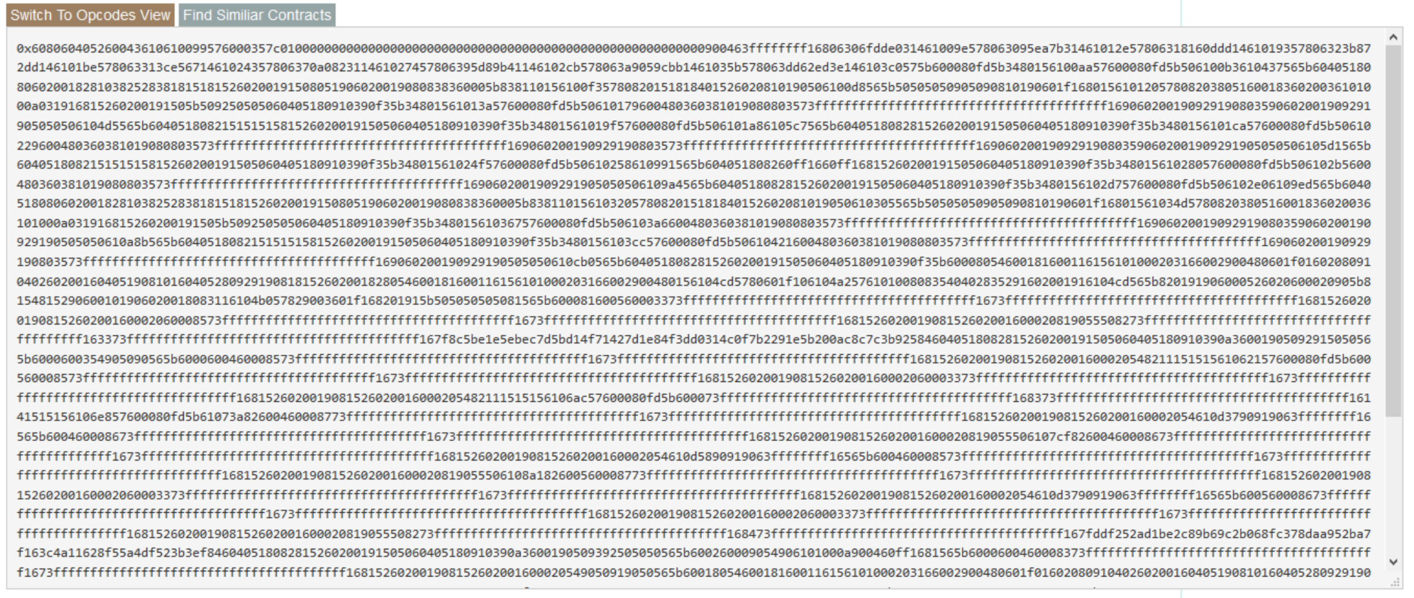
Bytecode Source Code on Chain
U. Gallersdörfer, P. Holl, and F. Matthes, “Blockchain-based Systems Engineering – Lecture Slides,” Oct 2019. [Online]. Available: https://github.com/sebischair/bbse

Slide 15
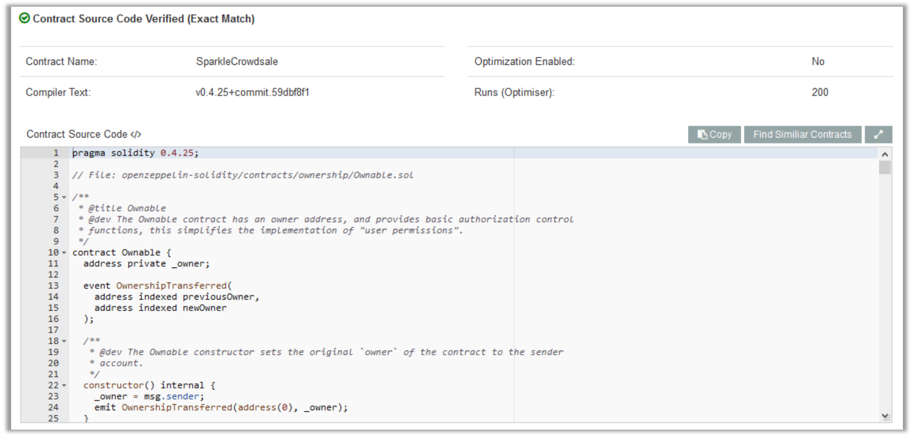
Publicly Available Source Code
Etherscan.io is a service which also verifies source codes and the respective byte code.
U. Gallersdörfer, P. Holl, and F. Matthes, “Blockchain-based Systems Engineering – Lecture Slides,” Oct 2019. [Online]. Available: https://github.com/sebischair/bbse

Slide 16
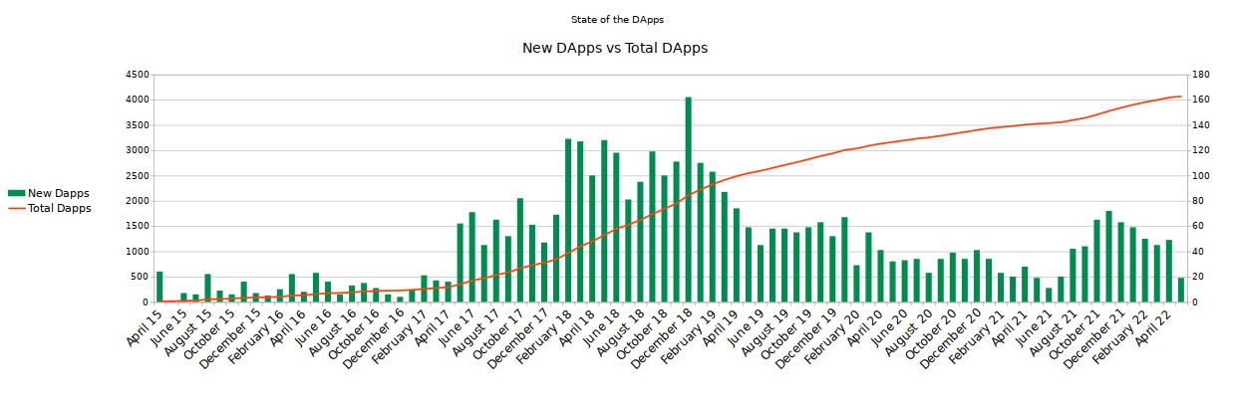
Web-based Ethereum dApps
State of the Dapps (Link) is a curated and community-driven directory of decentralized applications.
As of May 2022, the directory lists 4073 DApps (2970 Ethereum DApps).
Graph recreated based on data from https://www.stateofthedapps.com/stats

Slide 17
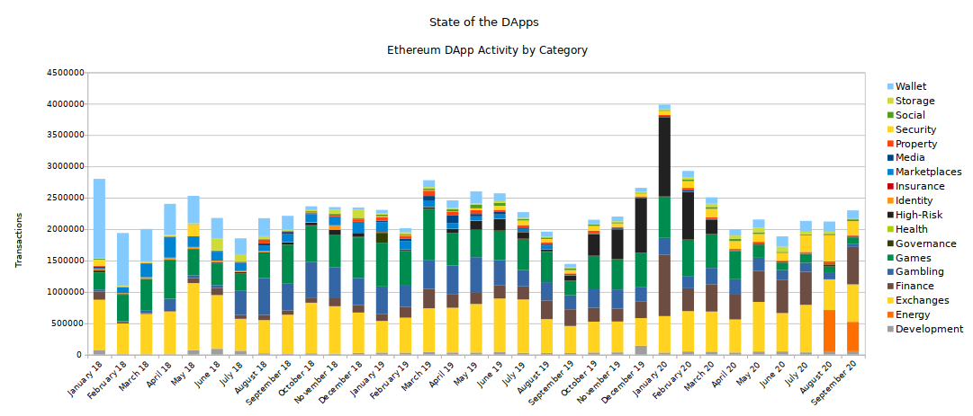
dApps Statistics – Transactions per dApp
Graph recreated based on data from https://www.stateofthedapps.com/stats

Slide 18
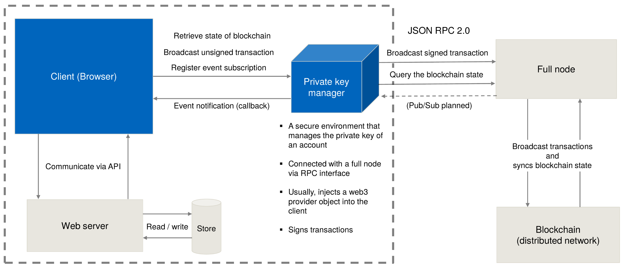
Architecture of Web-based dApps
U. Gallersdörfer, P. Holl, and F. Matthes, “Blockchain-based Systems Engineering – Lecture Slides,” Oct 2019. [Online]. Available: https://github.com/sebischair/bbse

Slide 19
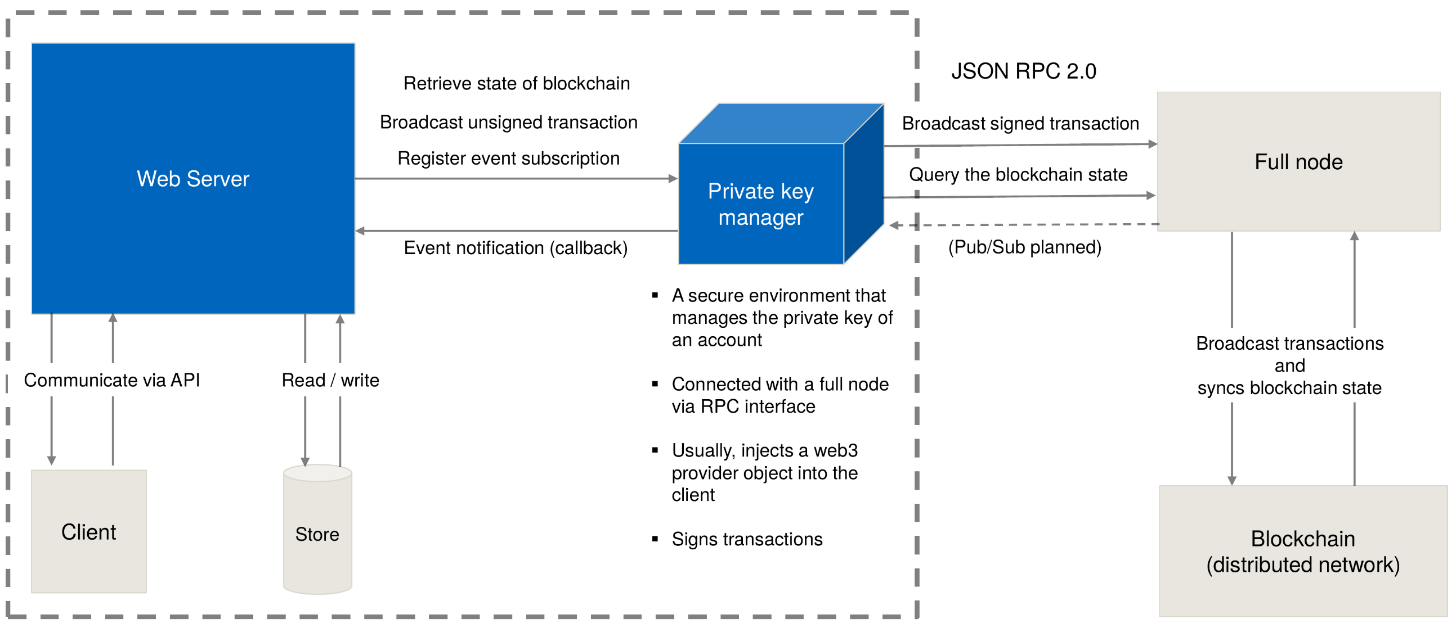
Architecture of Web-based dApps
U. Gallersdörfer, P. Holl, and F. Matthes, “Blockchain-based Systems Engineering – Lecture Slides,” Oct 2019. [Online]. Available: https://github.com/sebischair/bbse

Slide 20
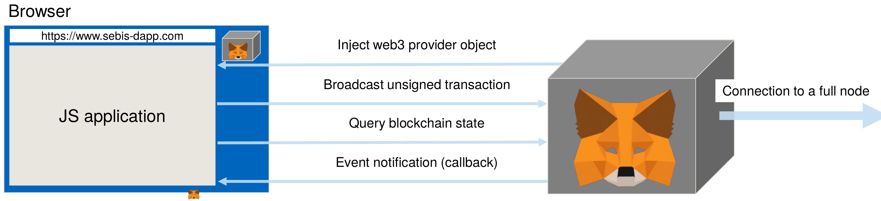
Metamask
U. Gallersdörfer, P. Holl, and F. Matthes, “Blockchain-based Systems Engineering – Lecture Slides,” Oct 2019. [Online]. Available: https://github.com/sebischair/bbse

Slide 21
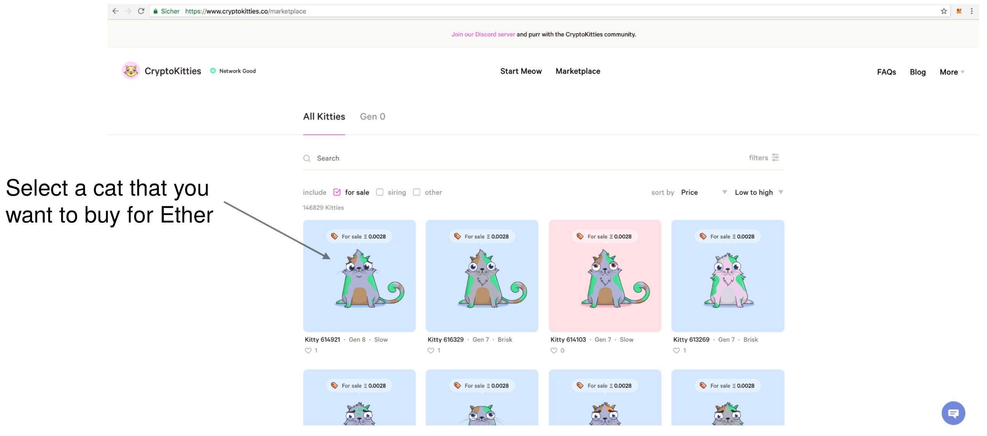
Example: CryptoKitties
U. Gallersdörfer, P. Holl, and F. Matthes, “Blockchain-based Systems Engineering – Lecture Slides,” Oct 2019. [Online]. Available: https://github.com/sebischair/bbse

Slide 22
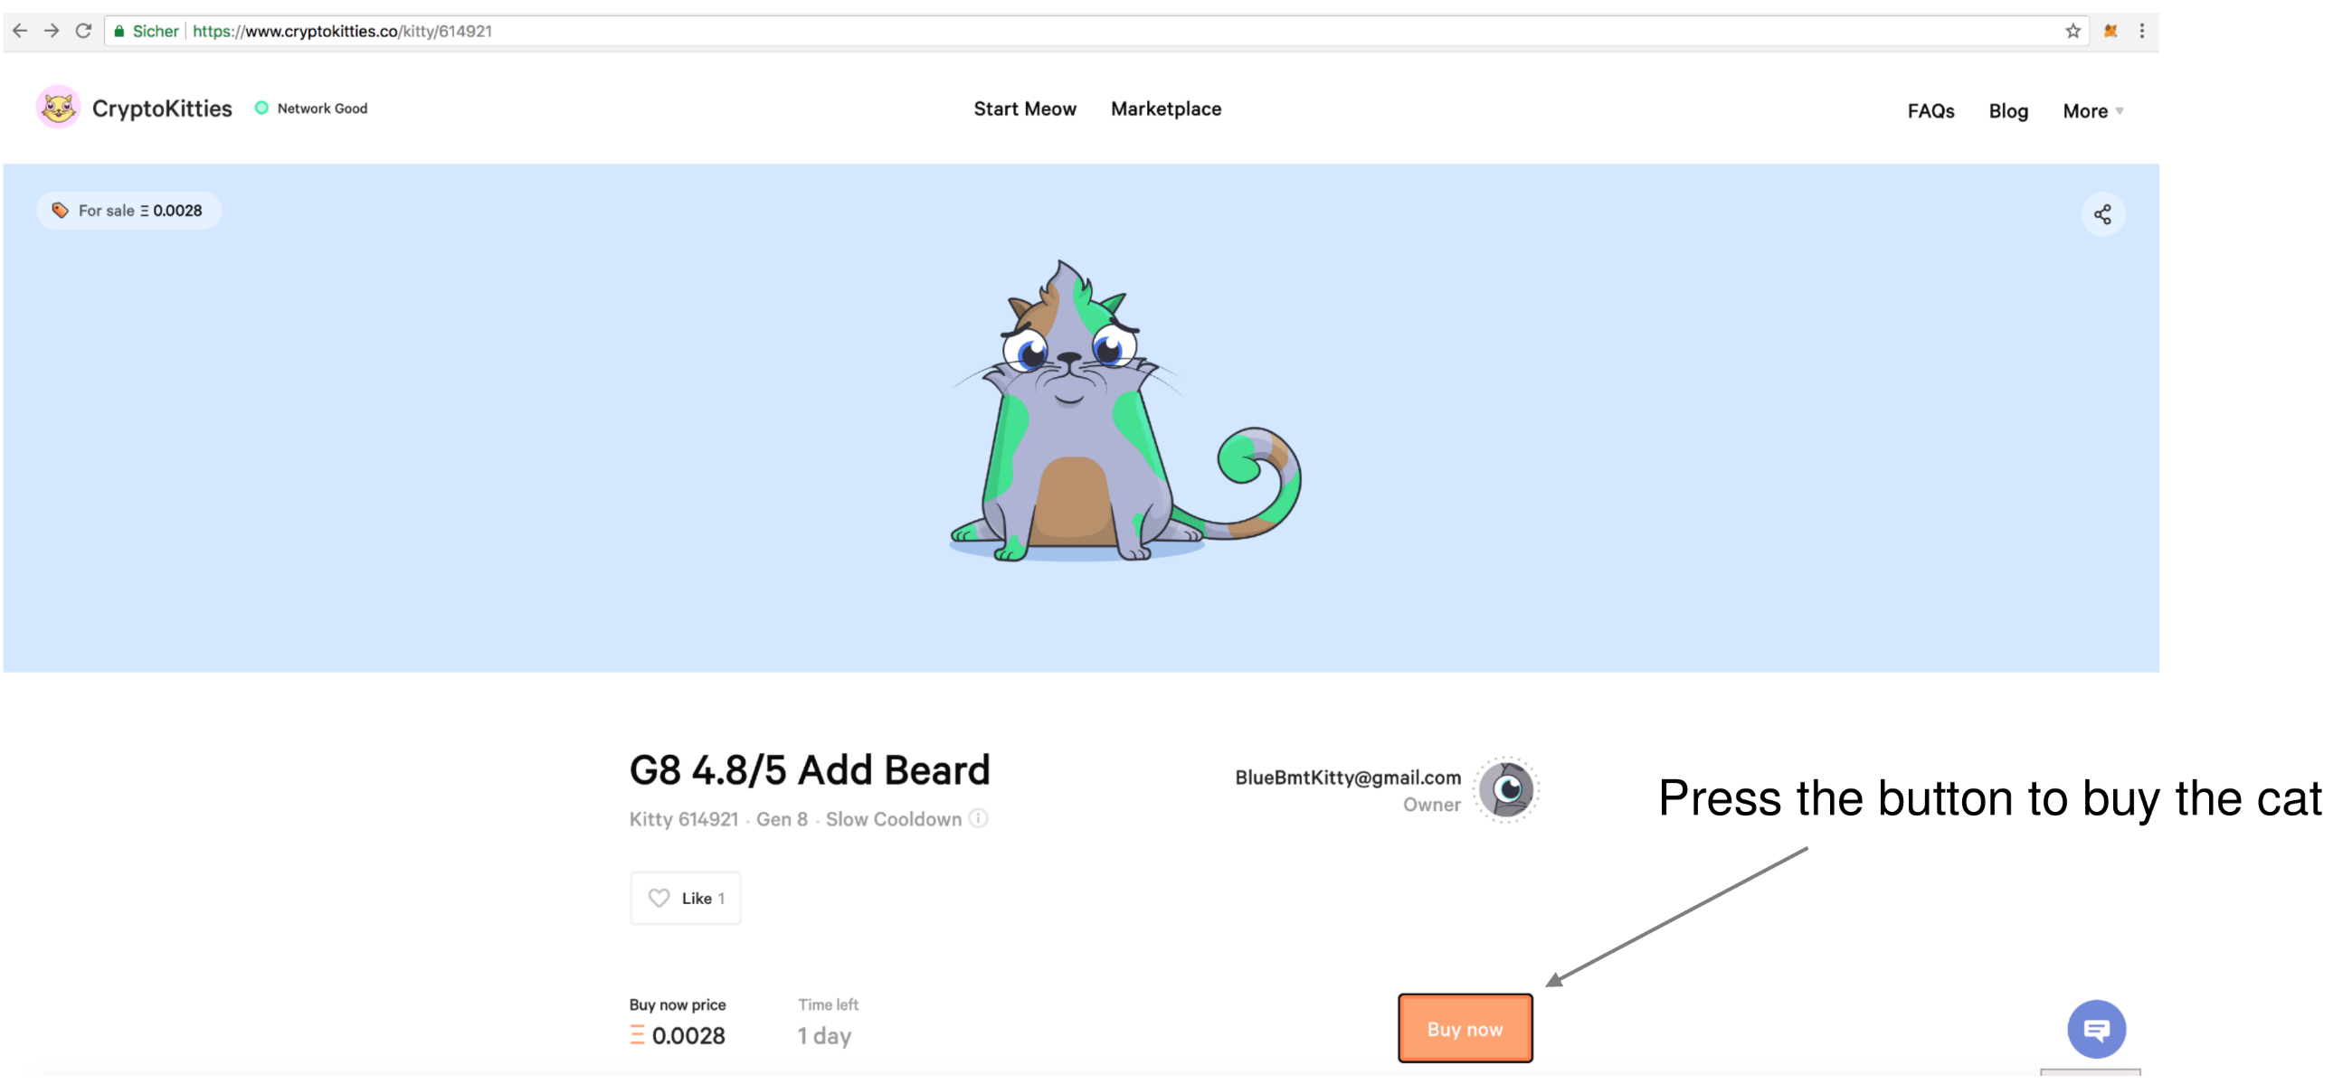
Example: CryptoKitties
U. Gallersdörfer, P. Holl, and F. Matthes, “Blockchain-based Systems Engineering – Lecture Slides,” Oct 2019. [Online]. Available: https://github.com/sebischair/bbse

Slide 23
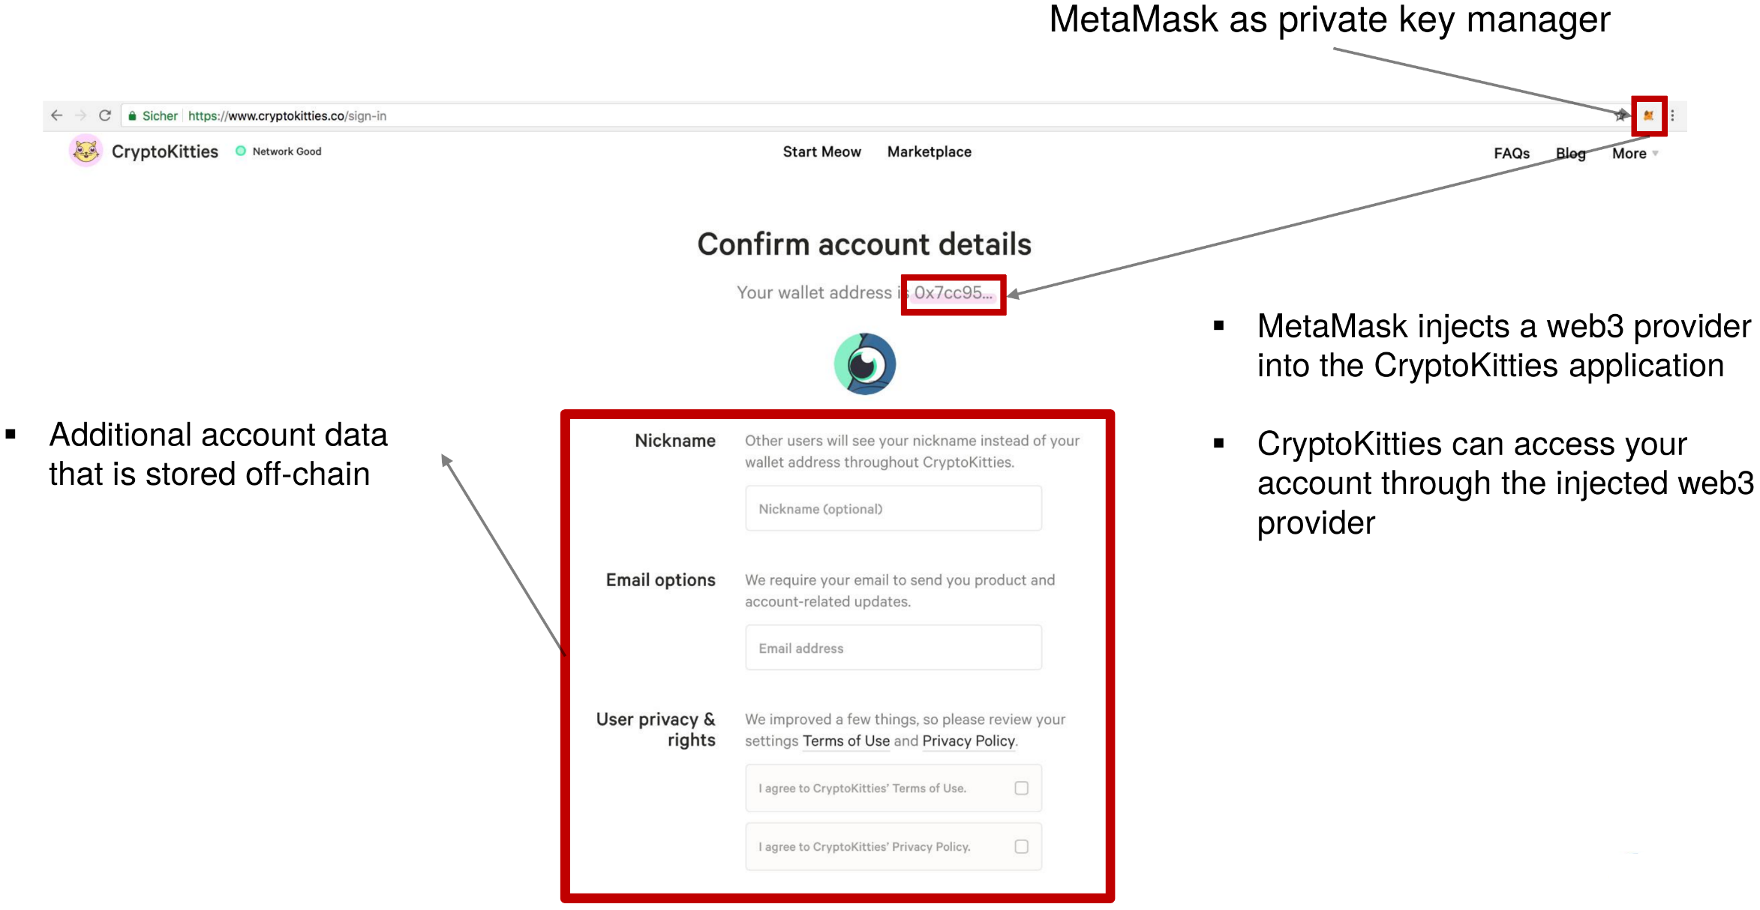
Example: CryptoKitties
U. Gallersdörfer, P. Holl, and F. Matthes, “Blockchain-based Systems Engineering – Lecture Slides,” Oct 2019. [Online]. Available: https://github.com/sebischair/bbse

Slide 24
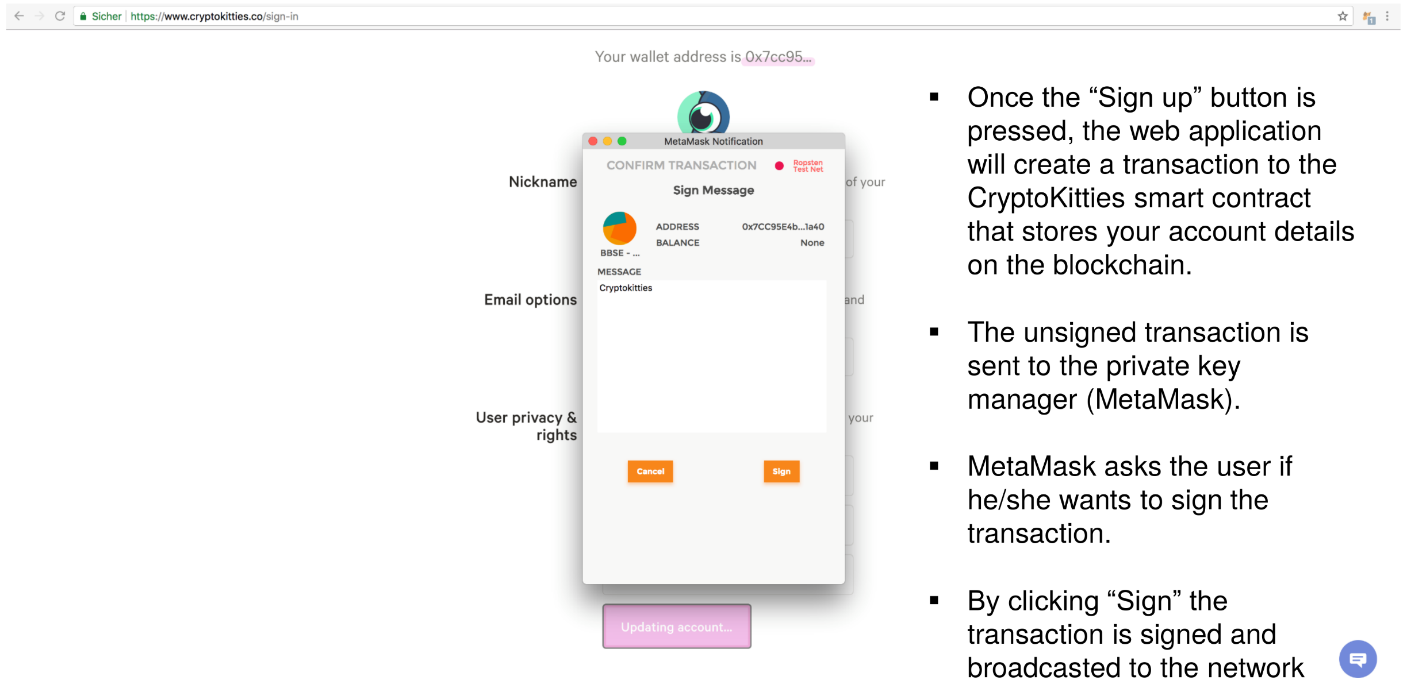
Example: CryptoKitties
U. Gallersdörfer, P. Holl, and F. Matthes, “Blockchain-based Systems Engineering – Lecture Slides,” Oct 2019. [Online]. Available: https://github.com/sebischair/bbse

Slide 25
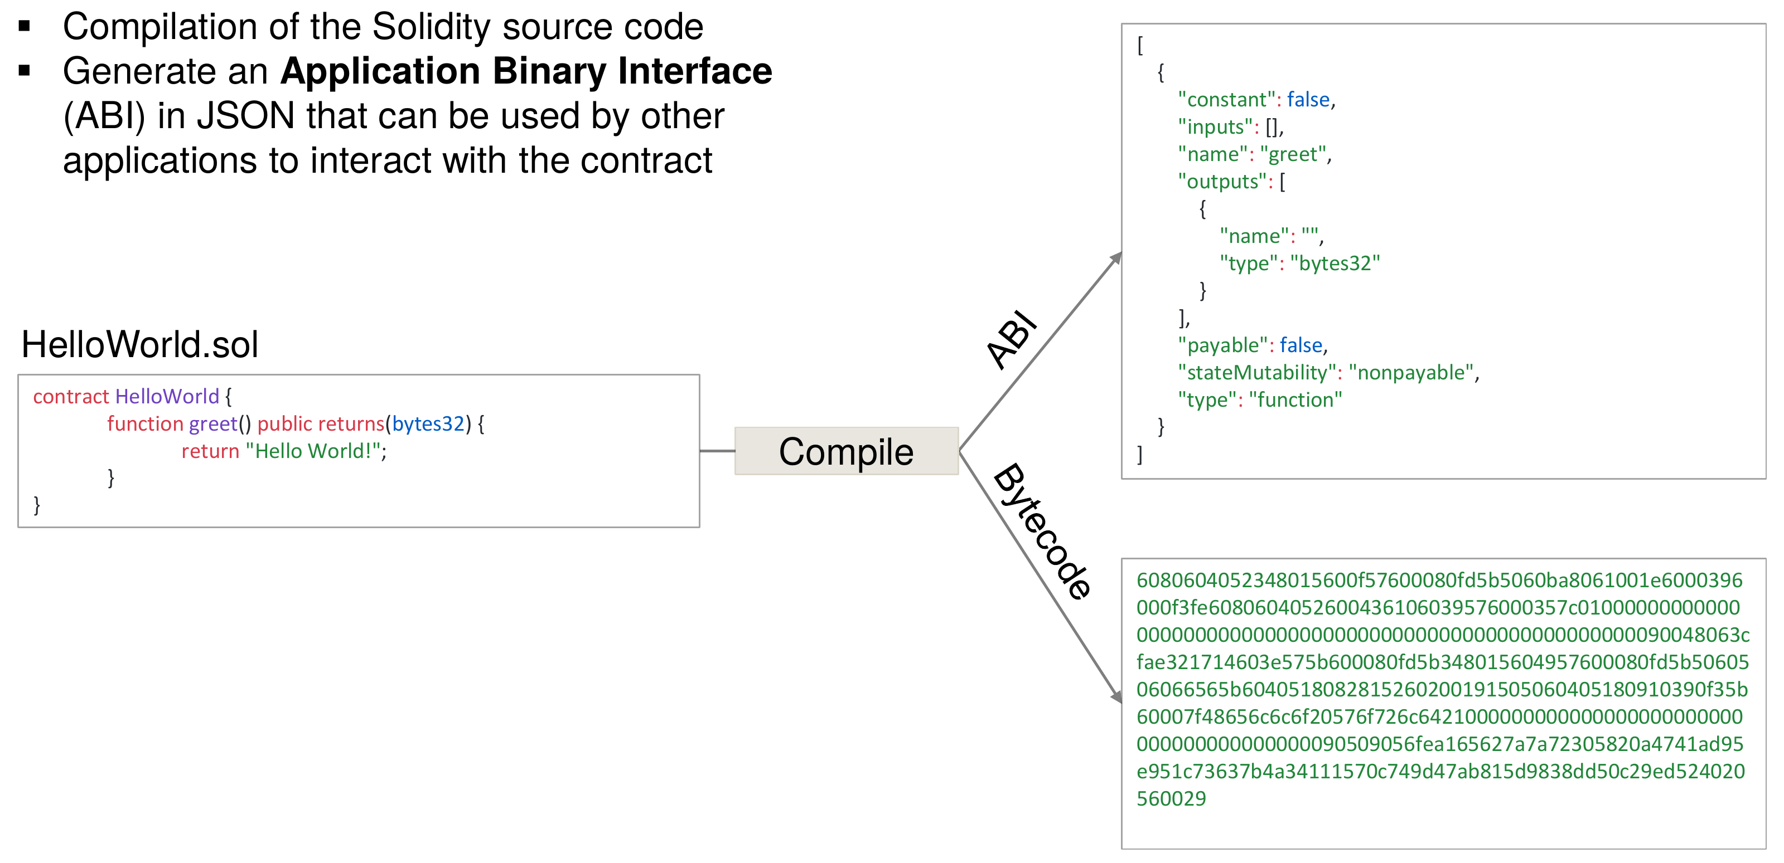
Deployment Lifecycle
U. Gallersdörfer, P. Holl, and F. Matthes, “Blockchain-based Systems Engineering – Lecture Slides,” Oct 2019. [Online]. Available: https://github.com/sebischair/bbse

Slide 26
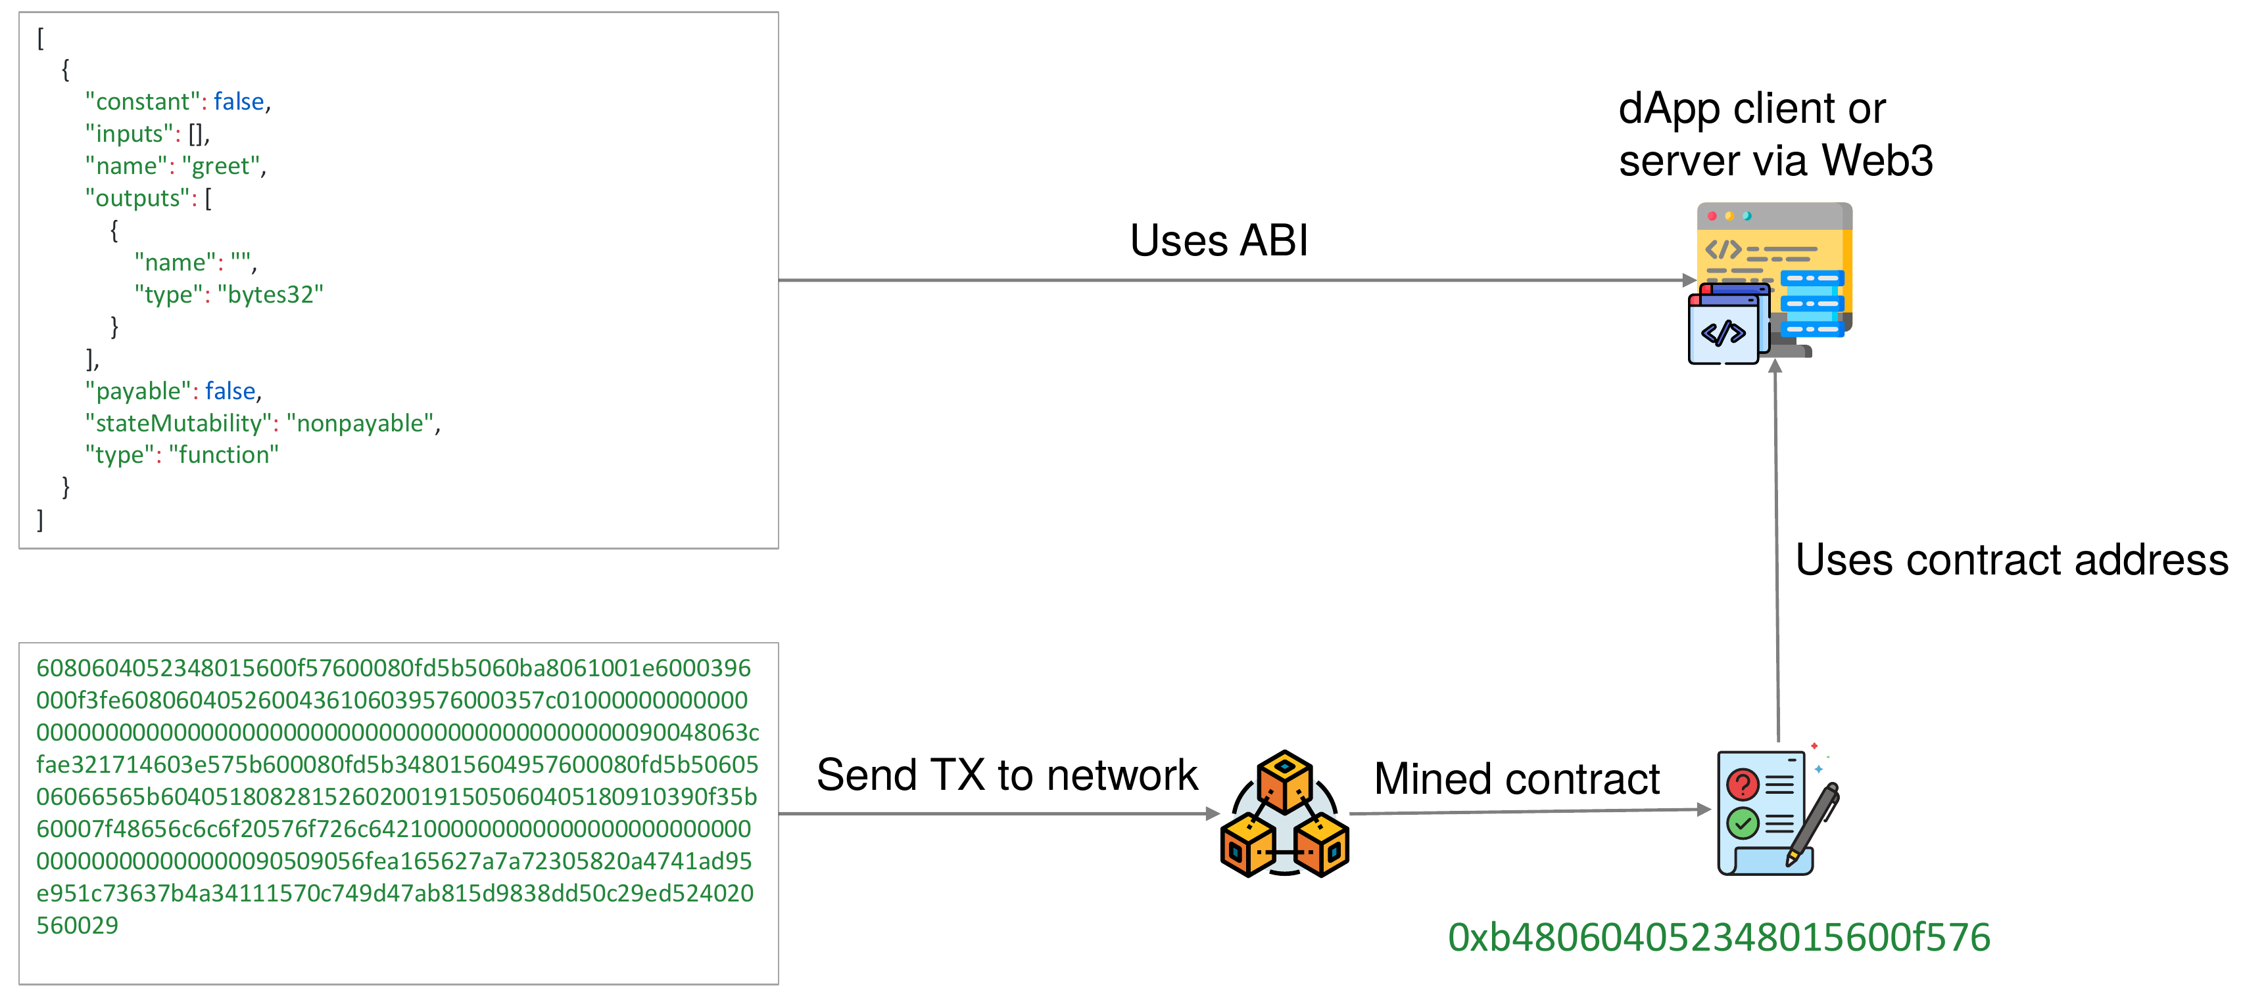
Deployment Lifecycle
U. Gallersdörfer, P. Holl, and F. Matthes, “Blockchain-based Systems Engineering – Lecture Slides,” Oct 2019. [Online]. Available: https://github.com/sebischair/bbse

Slide 27
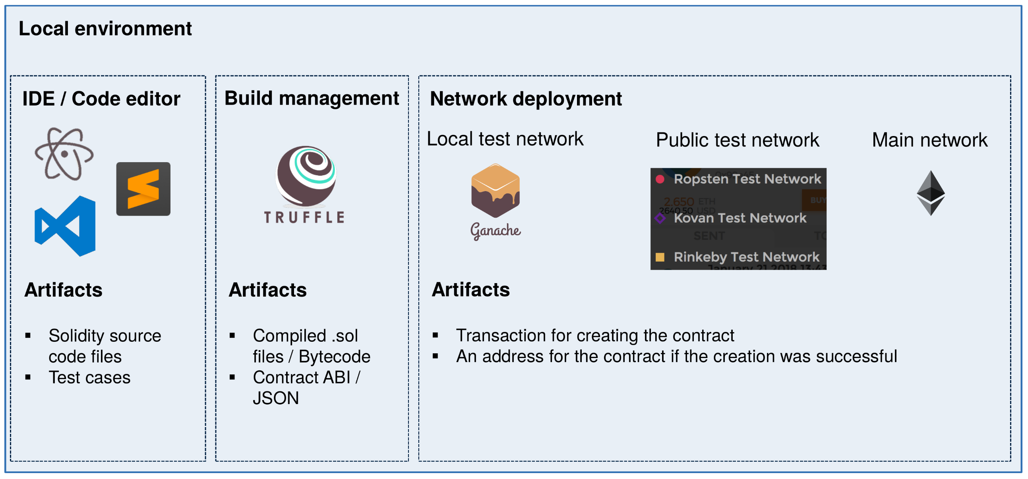
Development Tools
U. Gallersdörfer, P. Holl, and F. Matthes, “Blockchain-based Systems Engineering – Lecture Slides,” Oct 2019. [Online]. Available: https://github.com/sebischair/bbse

Slide 28

Truffle – Development Framework for Smart Contracts
Truffle is a popular framework to facilitate the development of Ethereum smart contracts. It provides tools to compile, test and deploy Solidity contracts.
Open source – Github
Built-in network management that allows a developer to deploy a smart contract on various networks, e.g., live and test
Web-pack like automated re-compilation on code change
Provides project scaffolding

Slide 29

Ganache – Private Ethereum Test Network
Ganache is a local blockchain for Ethereum smart contract development. It can be used to deploy, simulate, and test smart contracts.
Open source – Github
Integrates a custom block explorer interface with additional
debugging features.
Uses workspaces to provide multiple Ethereum blockchains
with different settings (blocktime etc.)
Can be linked to Truffle projects to automate tests for smart
contracts

Slide 30
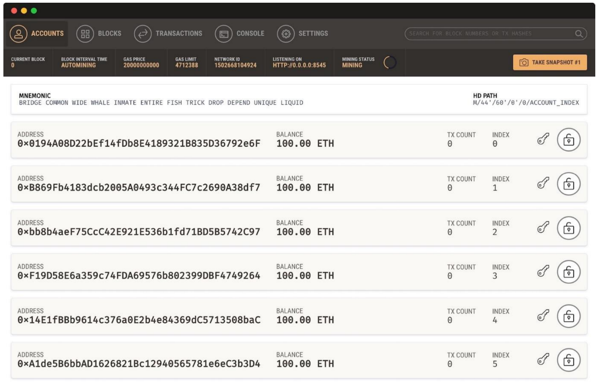
Ganache – Private Ethereum Test Network
Ganache ships with a ready-made and developer friendly block explorer:
U. Gallersdörfer, P. Holl, and F. Matthes, “Blockchain-based Systems Engineering – Lecture Slides,” Oct 2019. [Online]. Available: https://github.com/sebischair/bbse

Slide 31
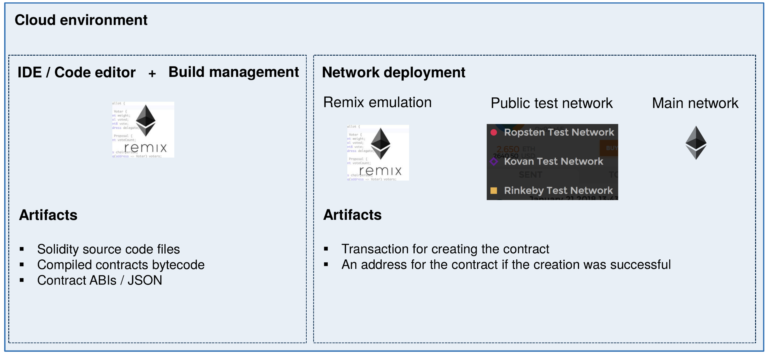
Development Tools
U. Gallersdörfer, P. Holl, and F. Matthes, “Blockchain-based Systems Engineering – Lecture Slides,” Oct 2019. [Online]. Available: https://github.com/sebischair/bbse

Slide 32
Remix IDE
Demo in Excercise Session

Slide 33
Test Networks – Ropsten
Free to use
Public
Block time of ca. 30s
Proof-of-Work consensus
Geth and Parity compatibility
Ether distribution via faucet – Link
Anonymous

Slide 34
Test Networks – Rinkeby
Free to use
Public
Block time of ca. 15s
Proof-of-Authority consensus, i.e., one central instance decides what transaction will be mined.
Geth only
Ether distribution via faucet – Link
Twitter or Facebook account required (Spam/DoS protection)

Slide 35
Test Networks – Kovan
Free to use
Public
Block time of ca. 4s
Proof-of-authority consensus, i.e., one central instance decides what transaction will be mined.
Parity only
Ether distribution via faucet – Link
Github account required (Spam/DoS protection)

Slide 36
Now What?

Slide 37
Questions?

